Slide 1
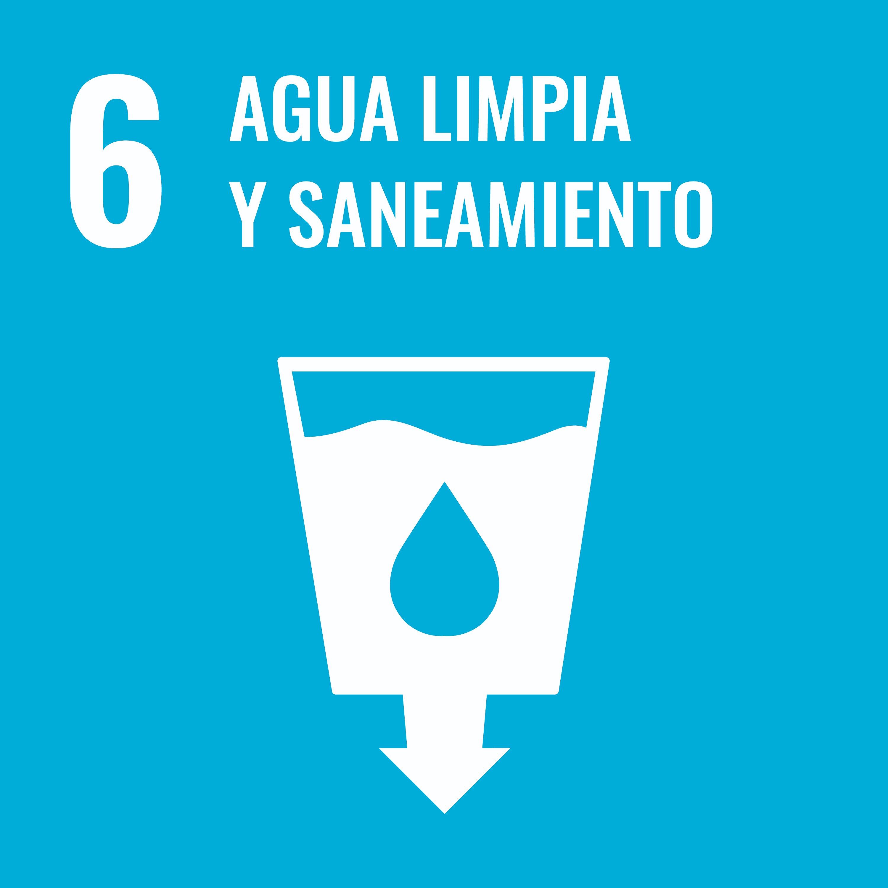
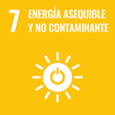
In 2021, Consorcio de Gestión del Puerto Dock Sud (CGPDS) became the first port in Argentina and in the region to be certified for the SDGs as a port authority through Cifal Argentina (UNITAR - UN).
We certified for SDG #5, 6, 7, 9, 12, 13, 16 and 17 (in 2022).
As part of SDG 7 we implemented the installation of solar water heaters made from recyclable waste. We present that Project in this document.
“We are committed to a development that satisfies the needs of the current generation, without compromising the needs and resources of future generations”

Slide 2
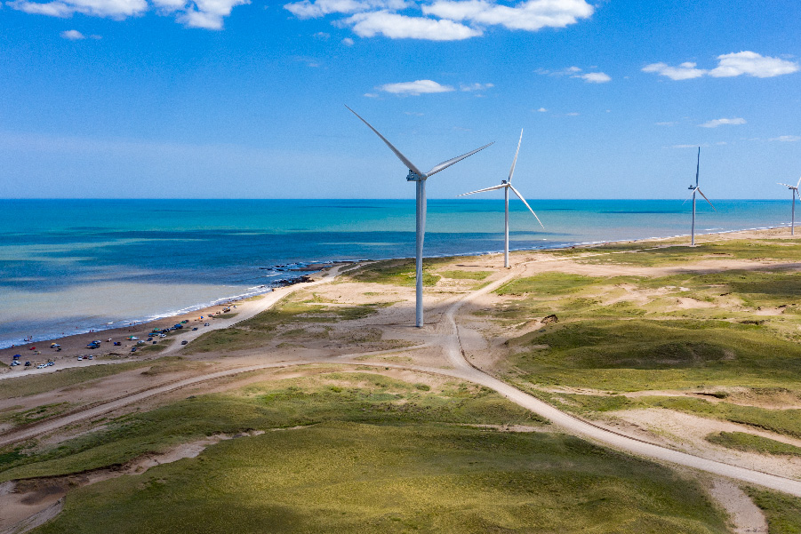
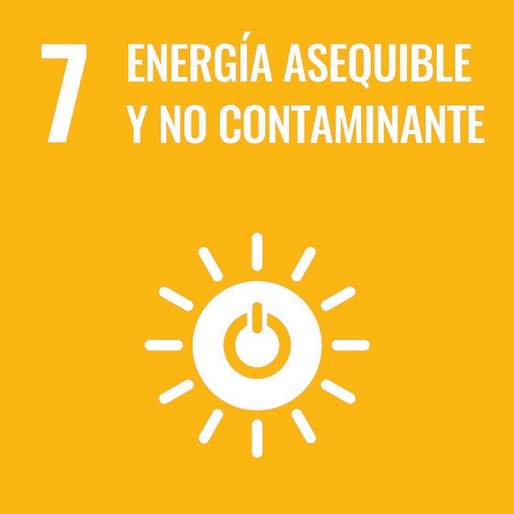
“Guarantee the access to affordable, reliable, sustainable and modern energy for all”

Slide 3
“Sustainable Solar Water Heaters” Project
In the framework of the prioritization of goals made in 2021, CGPDS chose to work on SDG 7 with the intention of promoting a transition towards less polluting fuels for different means of transportation.
Since it involved changing fuel sources in large cargo terminals, which implies an extended time of execution, we decided to add other projects with immediate impact to the SDG 7 strategy. The Project selected consists in installing solar water heaters in vulnerable communities around our port.
In this context, the SDG team redefined the initial proposal and concentrates its efforts on a project that allows us to foster renewable energies and promote the circular economy in a vulnerable social context. This new Project impacts on SDG 7 as well as in SDG 12, 13 and 16. All of them are certified.

Slide 4
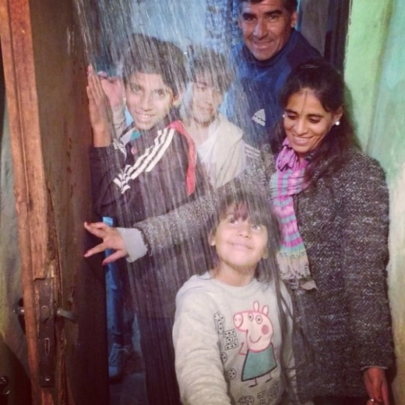
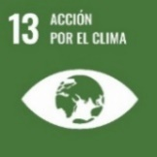
Action Plan
7. Promoting energy from renewable sources.
Aim: Foster and promote the use of energy from renewable sources to have a positive impact on the Puerto Dock Sud community.
Installing solar water heaters in zones administered by CGPDS.
Provide advice and training, and facilitate the installation of solar water heaters using recycled materials for the benefit of the vulnerable community surrounding our Port.

Slide 5
Port Communities
The neighborhood of Dock Sud is located in the Avellaneda district.
There is a variety of vulnerable communities in this neighborhood, such as:
- Barrio Inflamable [Flammable Neighborhood] which receives its name from to the proximity to the port hydrocarbons sector.
- Danubio Azul is the smallest, close to the general cargo area of the port.
- Isla Maciel: is on the other side of the highway and is adjacent to the largest container company in the country. It borders with Matanza and Riachuelo rivers.
- Villa Tranquila is the farthest from the port jurisdiction, but the most populated. Like Isla Maciel, it borders with Matanza andRiachuelo rivers.

Slide 6
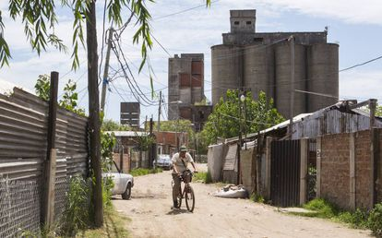
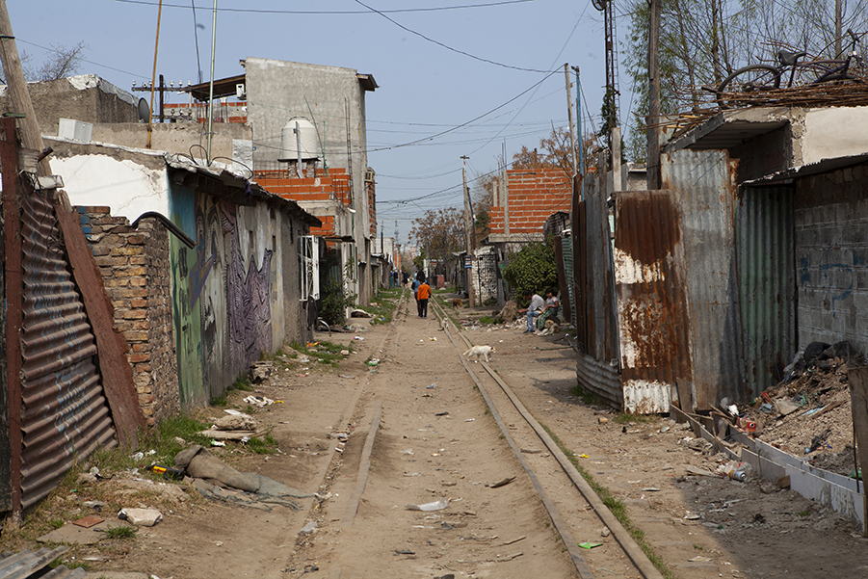
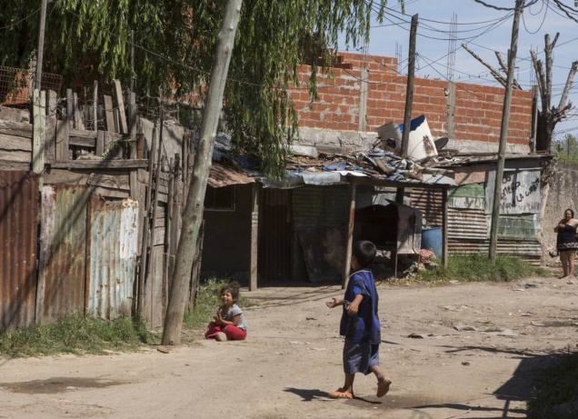
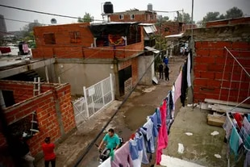
Vulnerability in the Community

Slide 7
Project Introduction
“Sumando Energías” is geared to building solar water heaters using recycled materials to install in vulnerable neighborhoods. It offers a training workshop to disseminate its goals.
In 2022 we organized a workshop with an NGO to build solar water heaters. The idea is to provide training and then deploy it through SDG teams and the vulnerable community surrounding the port.
We started planning and teaching CGPDS staff the techniques. They will then replicate what they learned and train the people in vulnerable communities in a concerted effort.
In September 2022, the team members of the SDG 7 participated in a workshop to build a solar water panel made from recycled materials using cans, bottles and PVC tubes, among others.

Slide 8
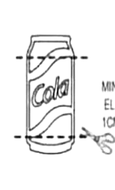
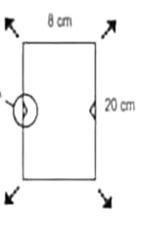
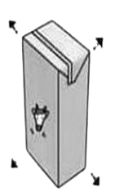
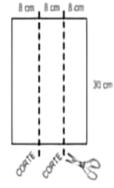
Preparation of Materials
BOTTLES
ALUMINUM CANS
IMPORTANT!
“Neck“ cut
The male cut is made one finger above the beginning of the upper curve in the bottle
Cut off the ends and flatten the aluminum to make 8x20 cm sheets
Cuts to take into consideration for assembly.
"Male“ cut
“Female“ cut
Bottom bottle
Top bottle
Small 1 cm nick to place the seal.
TETRABRIKS
Open up the container
Cut the container in three 8cm sections
Leave sheets flat

Slide 9
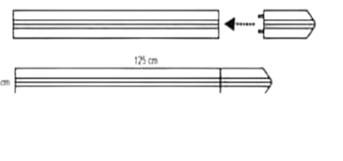
Preparation of Materials
STYROFOAM
Absorbing flaps
Cut away 2cm wide and 0.5 cm deep sections across the center of the Styrofoam boards.
2cm
Cut 3 of the 15 boards in 4 equal parts.
25cm
25cm
25cm
25cm
21cm
4cm
Cut diagonally as indicated.
2cm
Assemble the remaining 12 boards connecting them to the ends as indicated by the arrow using toothpicks or any other similar sharp object.
125cm

Slide 10
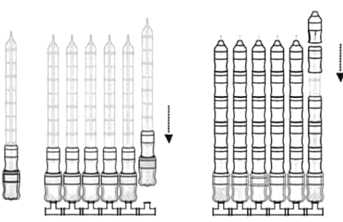
Assembly
Put two layers of Tetra Brik sheets on the Styrofoam board. Place six aluminum cans painted black on the Styrofoam. Then the PVC tube is added and hooked to each can using a seal.
Place 1.5 liter bottles and then 2.25 liter bottles on the absorbing flaps. The bottles must be placed female side down and male side up. Two equal modules are then assembled comprising 6 rows each. They are joined to form a 12 row grill.
(X12)
Place 15 clockwise turns of Teflon tape on the tubes before screwing them to the manifold.

Slide 11
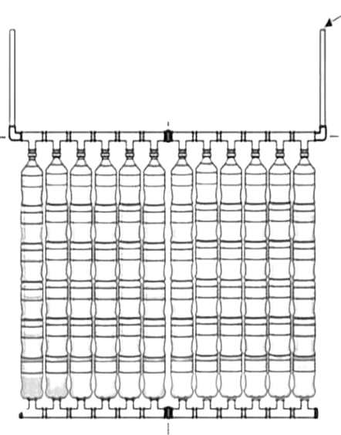
Assembly
Water inlet
Nipple
+
Elbow
Double joint
Nipple
+
Elbow
Once the tube and bottle grill is assembled it is connected with the coupling module to the upper part of 1/2’ tubes using double ½’ MH joints.
Join the two modules of the collector using two 1"HH double joints with a 1"x1“ cm nipple on each side. Place two 1” stoppers on the bottom ends and two 1” elbows on the upper ends.
Stopper
Stopper
Double joint
Once the general structure is completed, it is installed on the roof of the house. The membrane-covered canisters are placed on a previously installed structure. The solar panel is placed on that structure at a 45° angle, facing North.

Slide 12
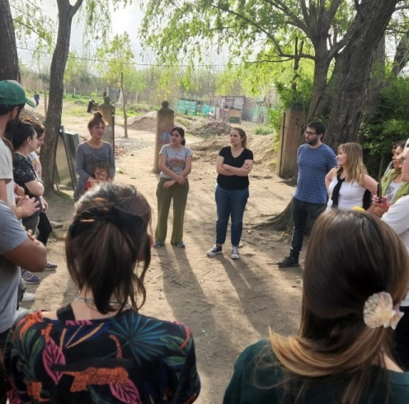
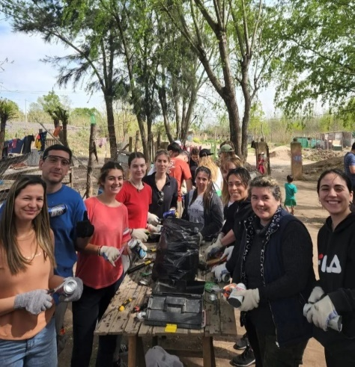
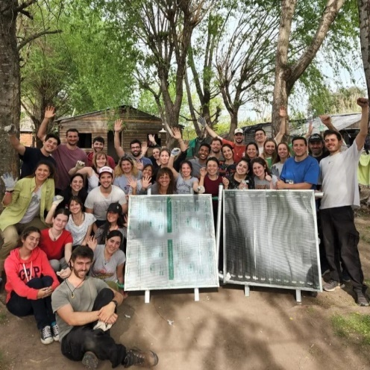
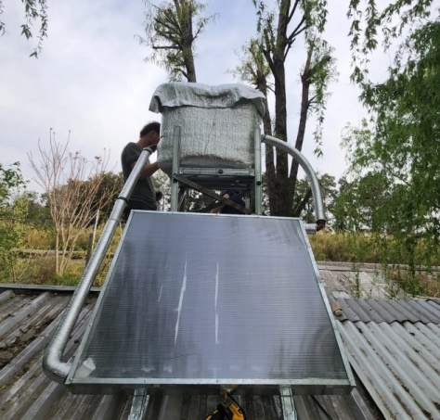
Results
Some of the CGPDS SDG team members participating in a workshop to build solar water heaters made from recycled materials for a vulnerable family in Pilar.
A solar water heater was built and installed next to the water tank and the shower to be used by the family.

Slide 13
Results
Image of a family having hot water for the first time.
These projects seek to create a positive impact on people’s lives creating an immediate change.
We hope to be able to accompany the families of our community through sustainable projects.

Slide 14
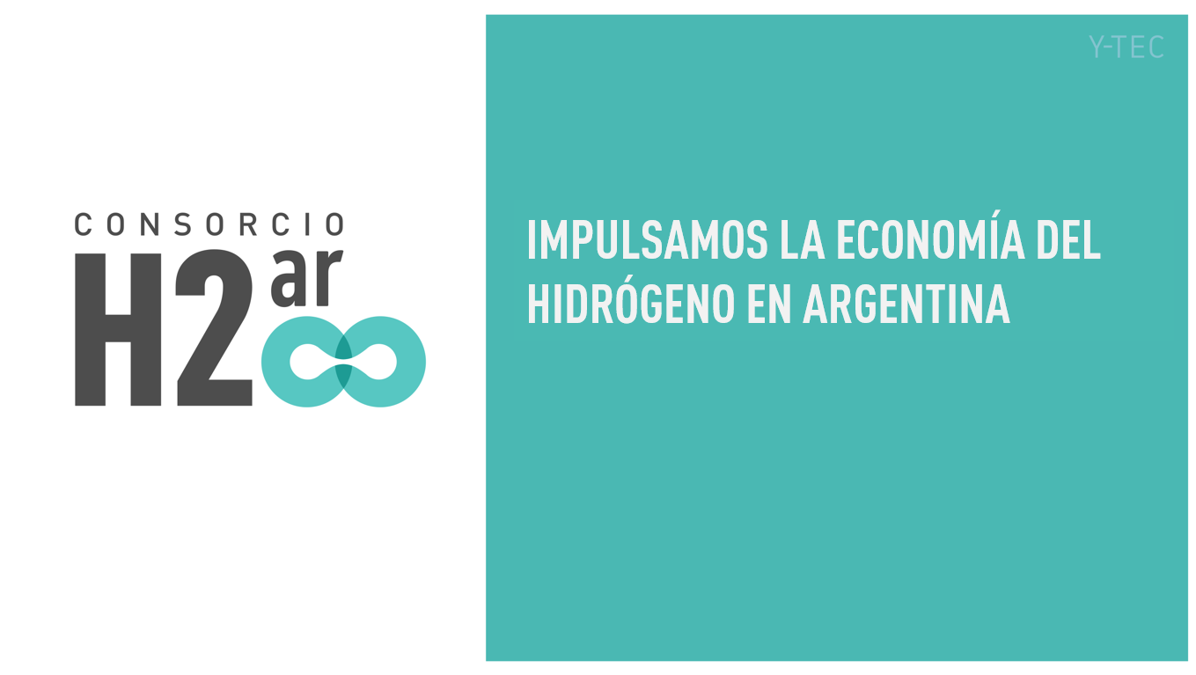
Other Initiatives
H2Ar is the hydrogen consortium in Argentina, and Y-TEC, a research division of this renewable energy. It belongs to the Argentine refinery, YPF SA.
Since 2021 CGPDS is part of it and hopes that our inclusion will allow CGPDS to actively participate in the country’s energy transition to hydrogen-based renewable energies. We provide our knowledge and experience in
fuel transportation, bunkering and export.

Slide 15
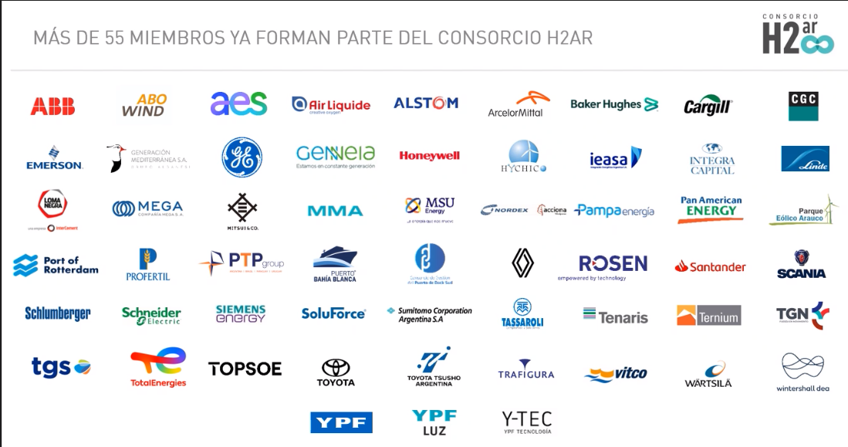
H2ar Consortium

Slide 16
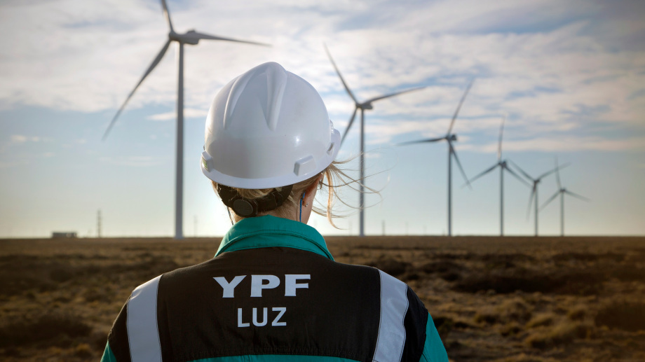
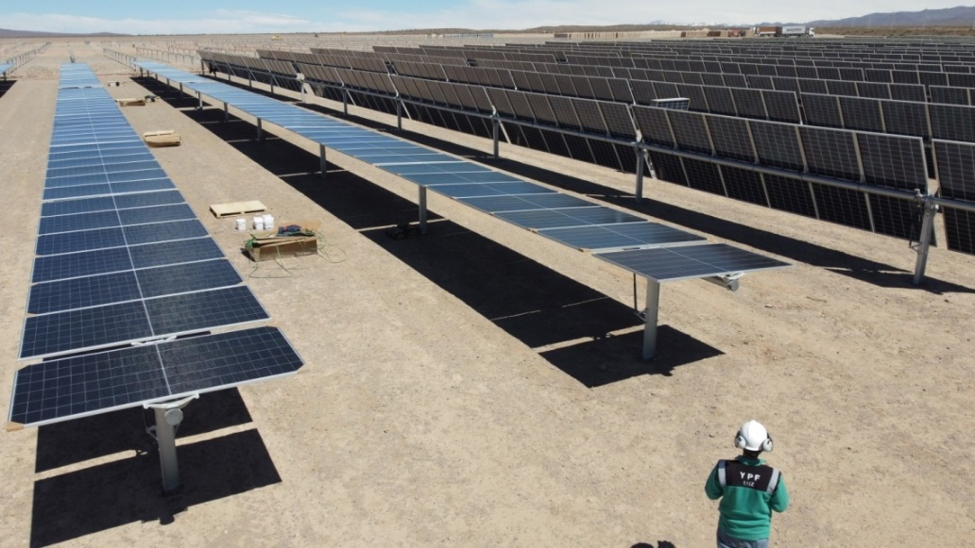
Procurement of Renewable Energies
Conversations are under way between CGPDS and YPF Luz to assess the likelihood of acquiring a percentage of our electricity consumption generated from renewable sources.

