Slide 1
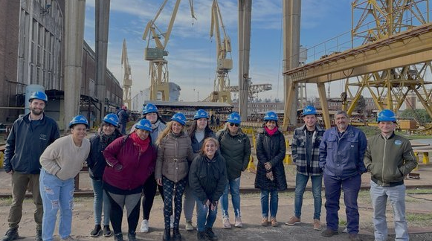
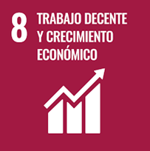
Committed to equality

Slide 2
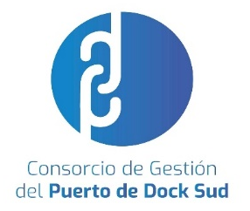
CGPDS Milestones:
A disruptive and committed management
What is CGPDS?
Carla Monrabal, president of CGPDS, is the first woman to reach a post of this magnitude in the province of Buenos Aires, and the second in the country.
The Consorcio de Gestión del Puerto de Dock Sud (CGPDS) is a public non-government-owned entity, with its own legal personality, and with financial, accounting and administrative Independence. Its aim is to administer, exploit and provide operational management to Puerto Dock Sud through the collection, administration and allocation of its own economic and financial resources.
The port is located in the city of Dock Sud, municipality of Avellaneda, province of Buenos Aires and it is one of the major ports in the country.
Modernization actions provided added value to the port. Now we have a sustainable, efficient and community-driven working environment.
The port became the first Argentine port to achieve the United Nations Sustainable Development Goals (SDG) certification.
A Gender Perspective Committee was created to promote equal opportunities. We seek to narrow the gap between men and women at the port.
We improved our numbers with the aim of getting indicators as close to equality as possible. At the beginning of our administration, women accounted for only 20 per cent of Jobs, while at present this number is beyond 35 percent.

Slide 3
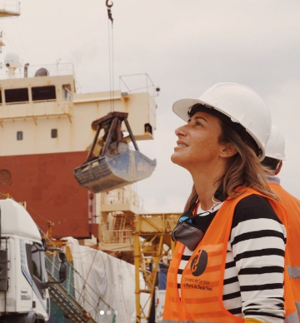
“Our most cherished wish is that more and more women become fit to work at the port to develop themselves professionally in the role they like, without having to comply with archaic constraints”.
Carla Monrabal
President of Consorcio de Gestión del Puerto de Dock Sud

Slide 4
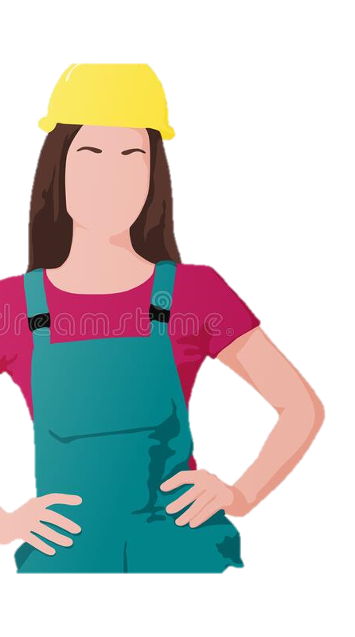
In the Search of More Equality
According to the province of Buenos Aires data, out of the 543 workers in port management consortiums 76% are men.
This same distribution is kept when considering managerial, decision-making posts.
Broken down by type of work, it is around 95% for dock, equipment operators and cleaning, safety and maintenance posts.
At CGPDS we conceived a program for the Port and the community. Its aim is for women to open up spaces in the labor market of masculinized crafts and occupations.
July
2022

Slide 5
From Diagnostic to Action:
The “Train for Work” Program
Aim:
Boost work opportunities aimed at women and LGTBI+ community persons in traditionally male crafts and occupations.
Key pillars:
Boost joint work among the State, companies, the port and the community.
Create skilled workers in the community.
Foster the inclusion of more women and members of LGBTI+ groups in port-related industries and ship building.
Reduce gender-related inequalities at work.

Slide 6
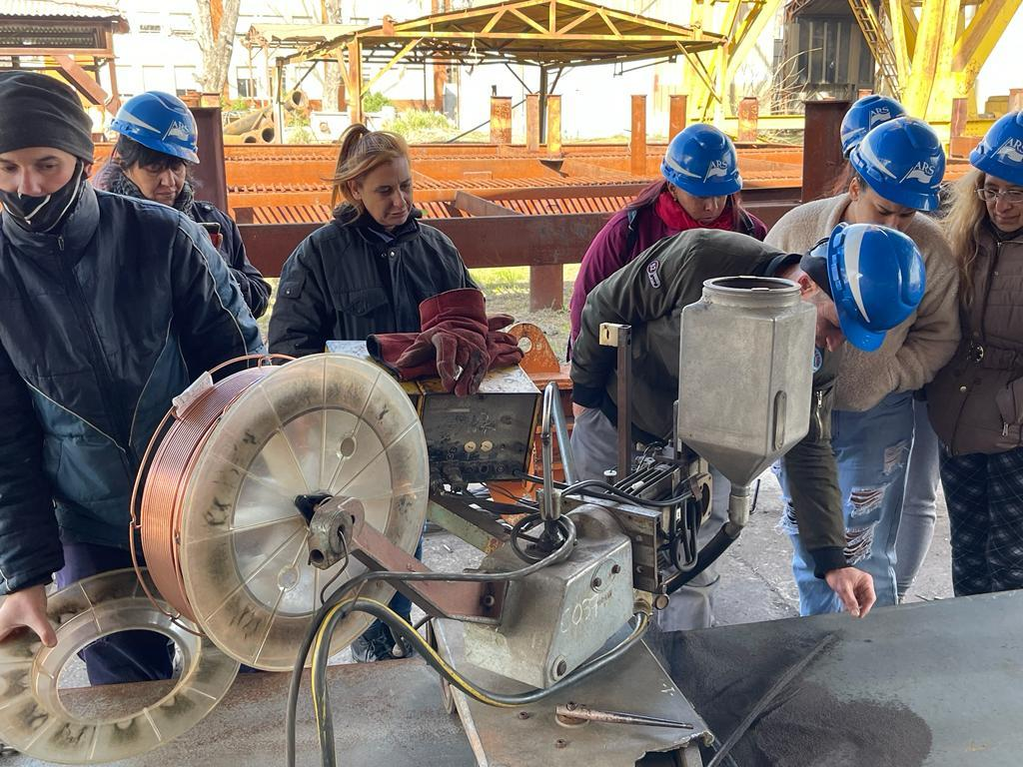
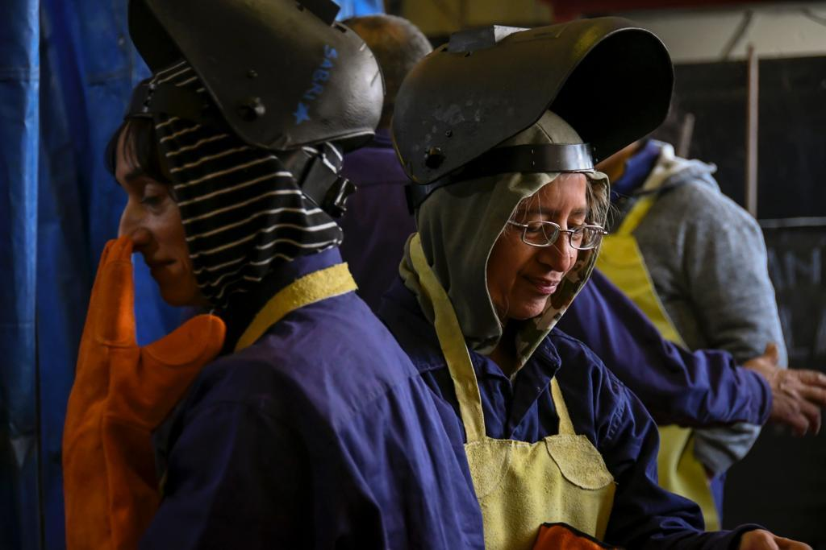
Implementation of the Training Program
CGPDS met with permission-holder companies interested in the program and obtained information about the crafts they needed.
We carried out a survey to obtain information about their needs. This allowed us to assess which were the crafts most needed, for example: welder and electrician posts.
We signed collaboration framework agreements between CGPDS and the Professional Training Center of (PBA 401) in Dock Sud for electricians and Astillero Río Santiago for welders.
We launched two training courses: Professional Welding and Industrial Electrician. The first one completed its first edition with a class of 8 women graduates. The second one will be completed in March 2023.

Slide 7
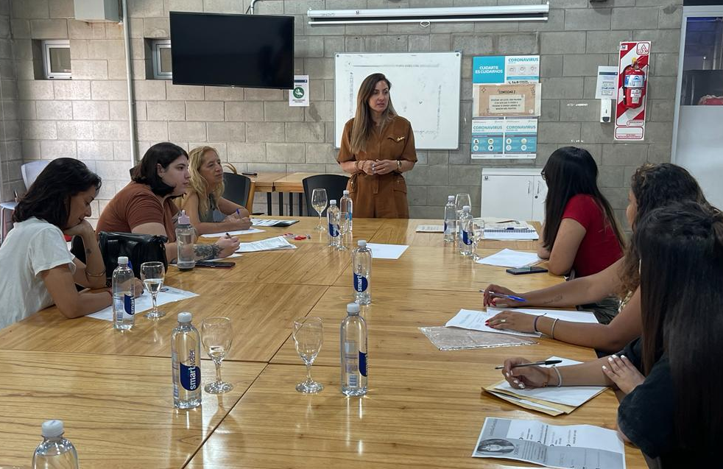
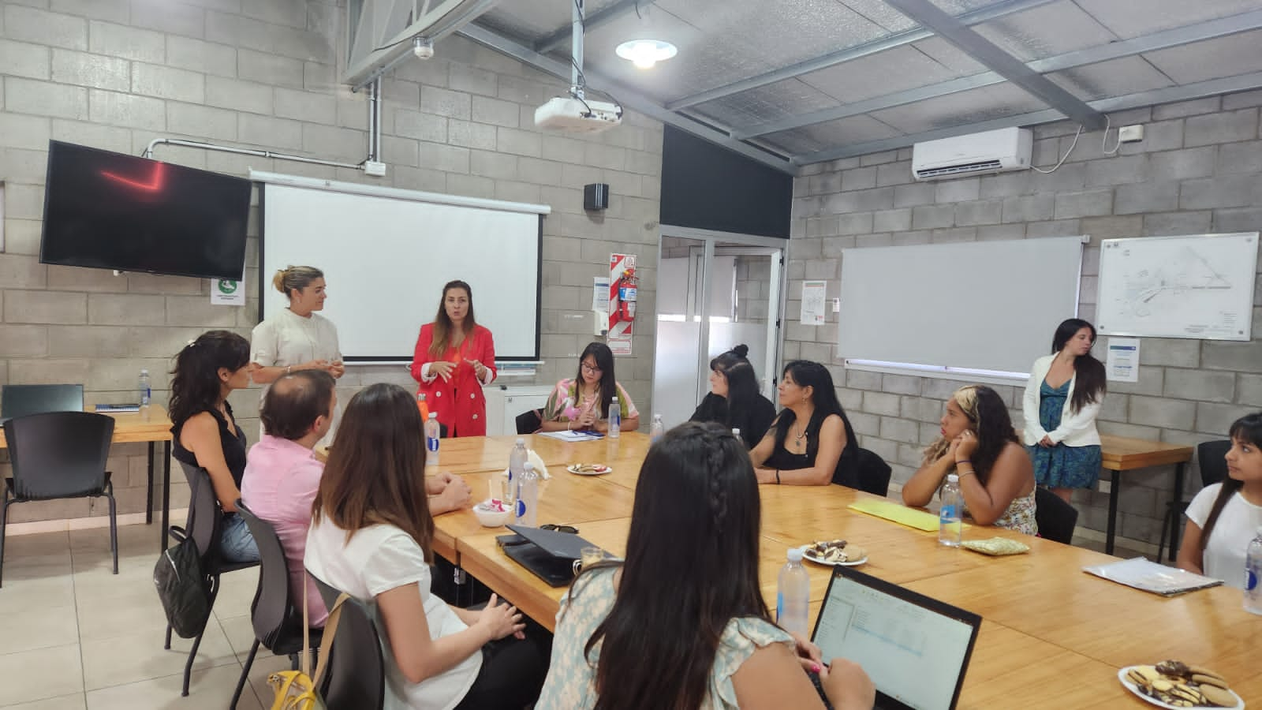
“Accompany and Provide Tools”:
Follow up towards employability
We sought to accompany and provided tools along the training process.
10
Activities to provide tools for employability
We conducted follow up actions on the persons who participated in the course by means of different activities.
We aim at boosting the creation of real opportunities and employment in the industry.

Slide 8
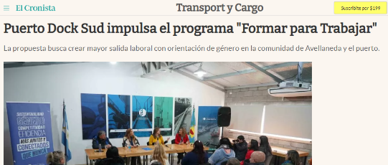
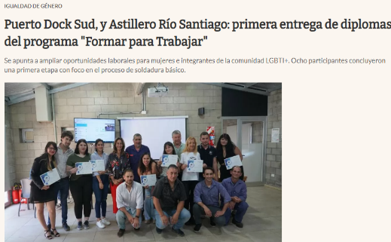
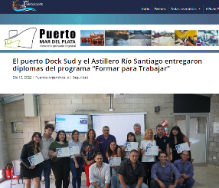
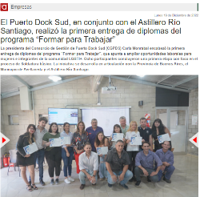
I
M
P
A
C
T
on the
P
R
E
S
S
Make the Actions Visible
Dissemination of the Program

Slide 9
“Train for Work” Program Aims and Achievements*
3
Partnerships and agreements to boost joint work between the State, companies, the port and the community.
2
Training courses taught in traditionally male crafts and occupations to create skilled labor in Avellaneda.
80%
Of women and LGTBI+ persons completed the training courses.
66%
Of effectiveness in the response rate to the demand of crafts and occupations in the industry.
*Based on the “Train to Work” program aims and indicators selected.

Slide 10
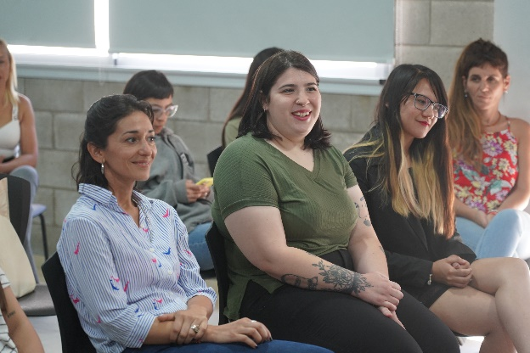
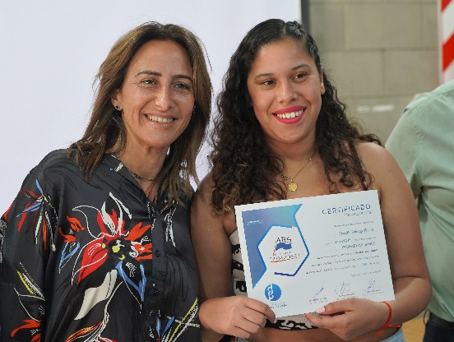
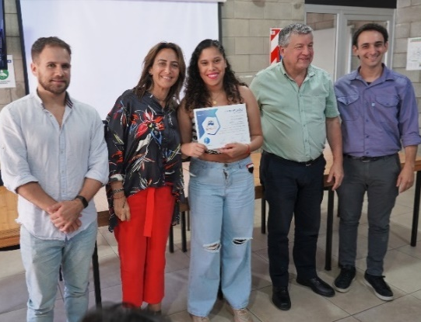
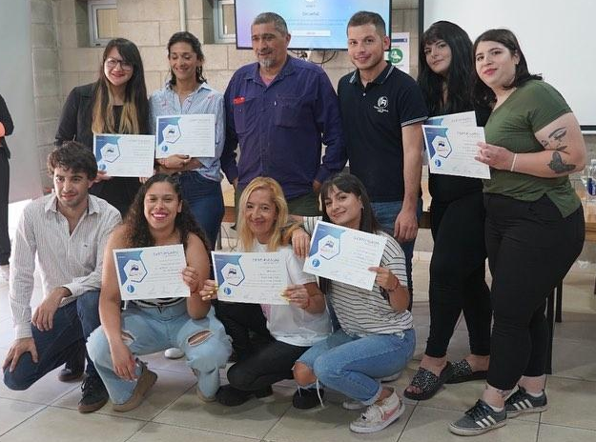
Searching for More Equality / Upcoming Challenges:
40
Women and LGTBI+ persons to be trained in Professional Welding courses in 2023
+
Partnerships to build
+
Training opportunities
+
Employment opportunities
8
Women & LGTBI+ persons trained in 2022

