Slide 1
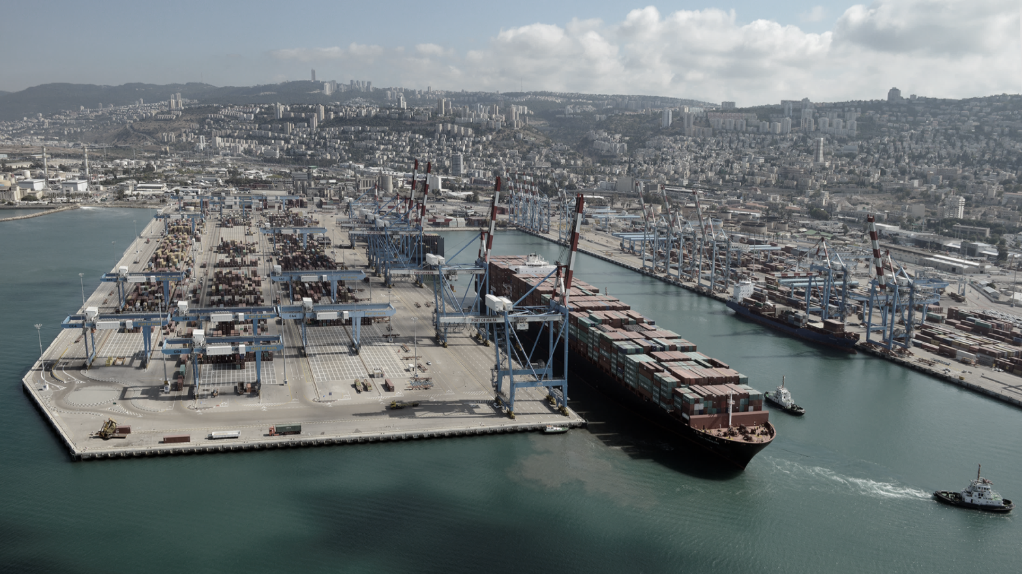
Digital application process for licensing and enforcement the export of hazardous waste
Ronen Mualem,
Manager, Maritime Community Applications

Slide 2
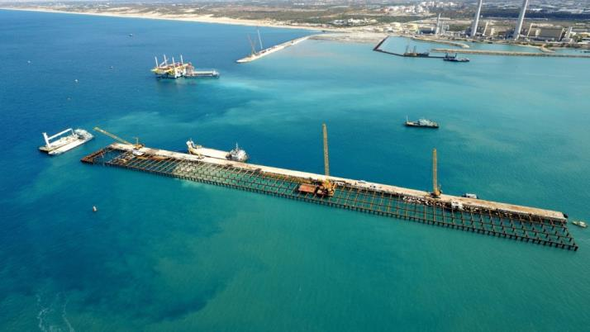
Israel Ports Company - IPC
99% of the Israeli
import and export is by sea
Ports in Israel
4 Cargo ports: Haifa, Israel Shipyards, Ashdod, Eilat
2 new Container Terminals Southport (operated by TIL) Bayport (operated by SIPG)
IPC responsibility: “Better maritime supply chain”
Real Estate Management & Maintenance of Israel’s seaports assets
Development of Israel’s seaports infrastructure, physical and digital

Slide 3
The problems in the process of the license application
Previous work process
Exporter use Email as platform to send the applications documents
Disadvantages
1.Deficiencies and inconsistencies in attaching all the required documents
2.Process with a lot of paperwork and forms
3. Errors in manually filled data
4. Inability to track the status of the application ON LINE
5. Difficulty checking compliance with the Basel Convention
6. Long processing time for applications until they are approved.

Slide 4
System advantages
Online Databse
Better Enforcement
Data Exchange
On line status
Quick Request/document search
Requires compliance with the rules of the Basel Convention
enables data checks and cross-checks
Monitoring of compliance with license conditions
Comparison of requested quantity to actual export
enables data exchange by e/massages with destination countries

Slide 5
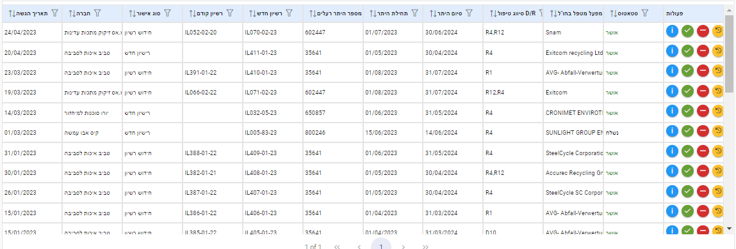
Screen for receiving all license applications for hazardous waste disposal
A screen where the Ministry of Environmental Protection receives all the requests entered by the exporters
Application submission date
Exporter
New/renewal license
Previous license
New license
Toxic permit number
Permit Beginning
Permit End
Handling treatment D/R
Processing factory abroad
Status
Functions

Slide 6
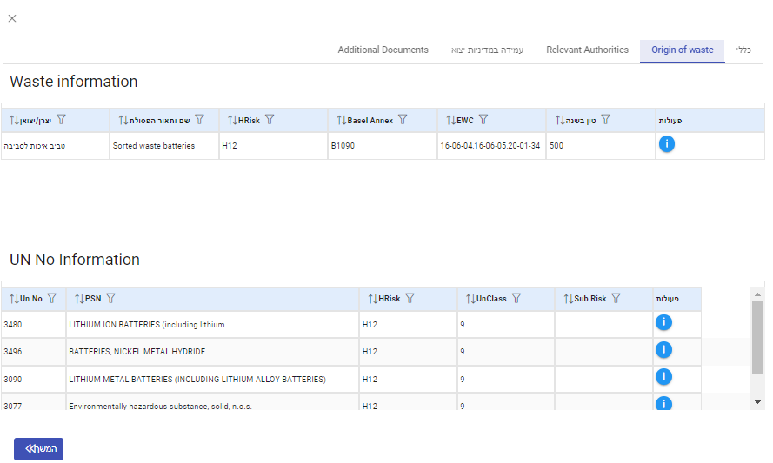
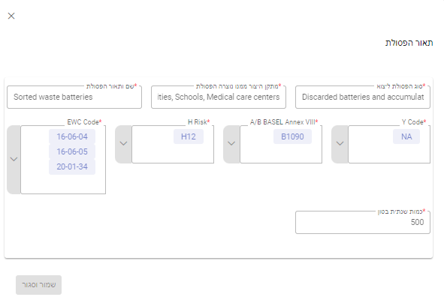
Screens for entering the request data
The input screens contain several parts
General data
Origin of waste data
Relevant authorities abroad data
compliance with the relevant export regulations
Additional requested documents

Slide 7
Thank you for your attention
For more information
Please contact
Ronen Mualem,
Manager, Israel Maritime Community Application
RONENM@ISRAPORTS.CO.IL

