Slide 1


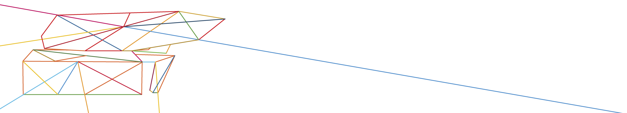


Communities and Innovation:
Working together towards sustainable maritime freight transport
Jan Hoffmann
Chief, Trade Logistics Branch, UNCTAD
Jan.Hoffmann@UNCTAD.org
https://twitter.com/UNCTAD_TLB
Insert your logo here

Slide 2
Three thoughts by way of introduction
1) Technological progress will never be as slow as today
2) A toolkit for sustainable freight transport
3) The need to better internalize externalities
Insert your logo here

Slide 3
Three thoughts by way of introduction
1) Technological progress will never be as slow as today
2) A toolkit for sustainable freight transport
3) The need to better internalize externalities
Insert your logo here

Slide 4
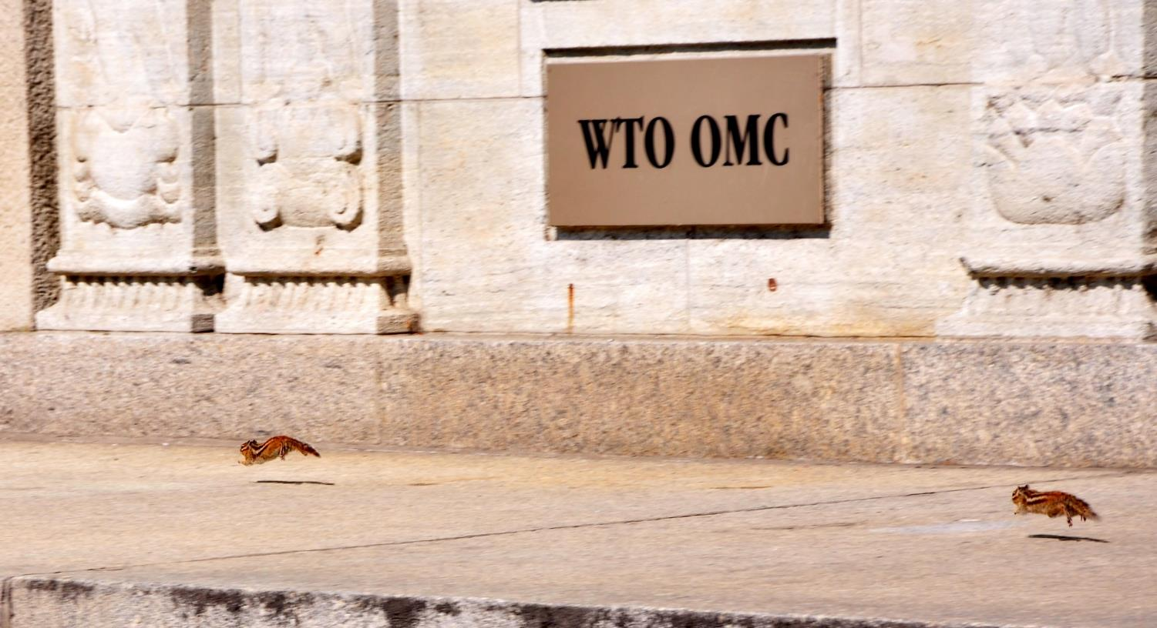

1) Technological progress will never be as slow as today
The mind set
How to set the rules and regulations for the future?

Slide 5

1) Technological progress will never be as slow as today
The mind set
The negotiation, ratification and implementation of conventions take time
Need to commit to whatever is the best [future] technological solution

Slide 6
Three thoughts by way of introduction
1) Technological progress will never be as slow as today
2) A toolkit for sustainable freight transport
3) The need to better internalize externalities
Insert your logo here

Slide 7
2) A toolkit for sustainable freight transport
The UNCTAD SFT Framework is a web-based step-by-step methodology that helps in planning, designing, developing, and implementing adequate strategies that promote sustainable freight transport systems.
The Framework is applicable within and across modes of transport and to different stakeholders (public and private) and in various geographical areas (national, regional, corridor, rural/urban, etc.)

Slide 8
Three thoughts by way of introduction
1) Technological progress will never be as slow as today
2) A toolkit for sustainable freight transport
3) The need to better internalize externalities
Insert your logo here

Slide 9
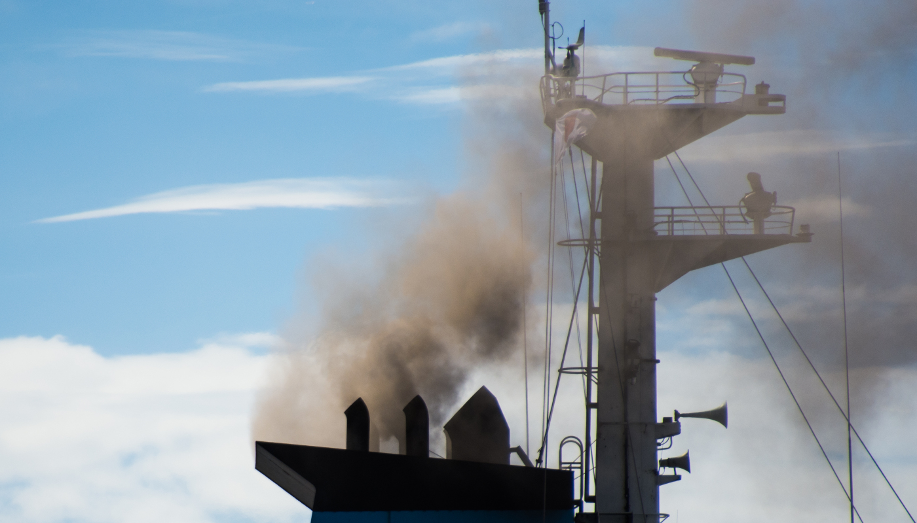
3) The need to better internalize externalities
While important initiatives already exist, shipping needs to play a larger role in addressing global warming and contribute to mitigating the carbon emissions that are causing climate change.
Shipping emits far less carbon dioxide (CO2) per ton-mile than any other mode of transport, but then due to its sheer volume it also produces many ton-miles.

Slide 10
3) The need to better internalize externalities
Could the industry be charged by its main regulatory body (IMO) not per ship tonnage (as is currently the case), but per tonne of CO2 emission?

Slide 11
Three thoughts by way of introduction
1) Technological progress will never be as slow as today
2) A toolkit for sustainable freight transport
3) The need to better internalize externalities
Insert your logo here

